Slide 1

Data Scientist Job Change Prediction
IT3190E - 123220
DSAI 01 K64
Team 3

Slide 2

Members & Contribution
Nguyễn Việt Hoàng
SID: 20194434
Hoang.nv194434@sis.hust.edu.vn
Phan Đức Thắng
SID: 20194452
Thang.pd194452@sis.hust.edu.vn
Tasks:
Explore: Thắng
Preprocess: Hoàng & Thắng
Logistic Regression model: Thắng
SVM model: Hoàng
Report: Hoàng & Thắng
Slides: Hoàng

Slide 3

Problem Statement
Goal: Predict if a data scientist will look for a job change and evaluate which factors affect his decision.
Use cases:
A company that is hiring employee can know among the candidates which one is really looking for a new job, which reduces the cost and time of finding new employees.
Predict which employee is likely to look for a job change and analyze which factors influent his decision.

Slide 4
Data
Feature | Type, domain | Description
enrollee_id | int64 [ 8949, 29725, 11561, ...,] | Unique ID for candidate.
city | object ['city_103', 'city_40', 'city_21', 'city_115', ...] | City code.
city_development_index | float64 [0.92 , 0.776, 0.624, 0.789, ...] | Development index of the city.
gender | object Domain: ['Male', nan, 'Female', 'Other'] | Gender of the candidate.
relevent_experience | object ['Has relevent experience', 'No relevent experience'] | Whether the candidate has relevent experience.
enrolled_university | object ['no_enrollment', 'Full time course', nan, 'Part time course'] | Type of University course the candidate enrolled.
education_level | object Domain: ['Graduate', 'Masters', 'High School', nan, 'Phd', 'Primary School'] | Education level of the candidate.
major_discipline | object Domain: ['STEM', 'Business Degree', nan, 'Arts', 'Humanities', 'No Major', 'Other'] | Education major discipline of the candidate.
experience | object ['>20', '15', '5', '<1', '11', '13', '7', '17', '2', '16', '1', '4', '10', '14', '18', '19', '12', '3', '6', '9', '8', '20', nan] | Candidate’s total experience, measured in years.
company_size | object [nan, '50-99', '<10', '10000+', '5000-9999', '1000-4999', '10/49', '100-500', '500-999'] | Number of employees in current employer's company.
company_type | object [nan, 'Pvt Ltd', 'Funded Startup', 'Early Stage Startup', 'Other', 'Public Sector', 'NGO'] | Type of current employer’s company.
last_new_job | object ['1', '>4', 'never', '4', '3', '2', nan] | Time interval between previous job and current job (in years).
training_hours | int64 [ 36, 47, 83, 52, 8, 24, 18, 46, 123, 32, ...] | Training hours completed.
2.1 Features
There are 19158 examples
Each example in the dataset is a 13 x 1 vector with the following features:

Slide 5
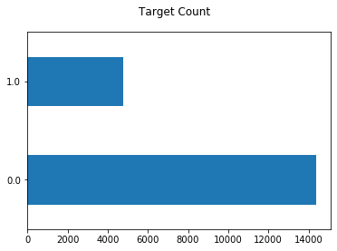
Label
An assigned label of either “yes” or “no” for the question whether the candidate is looking for a new job.
Values:
0 – The candidate is not looking for a new job.
1 – The candidate is looking for a new job.

Slide 6
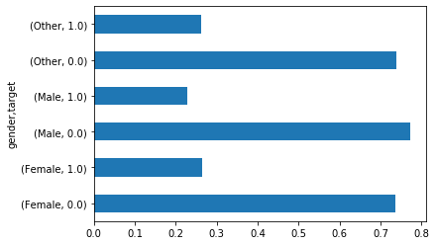
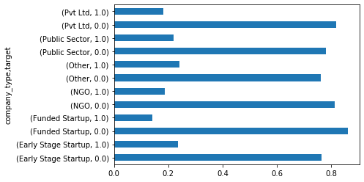
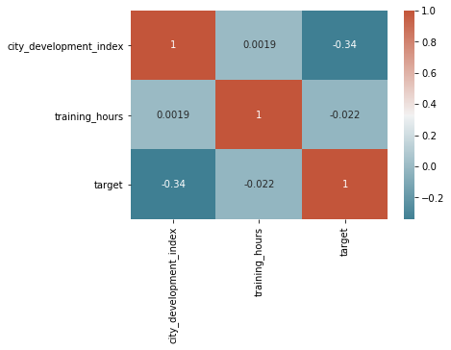
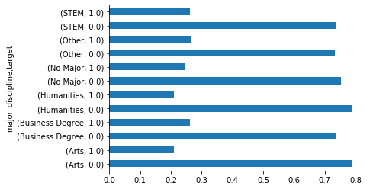
Explore
Categorical features
Numerical features

Slide 7
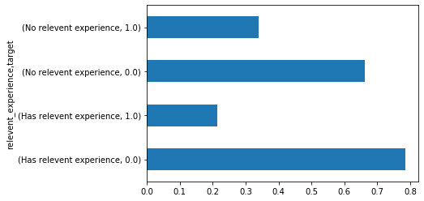
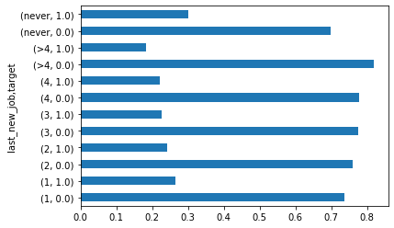
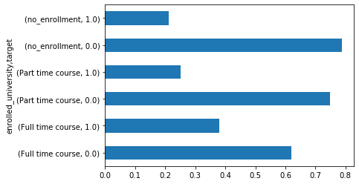
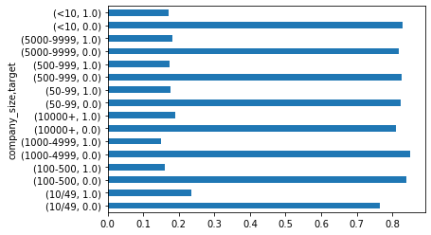
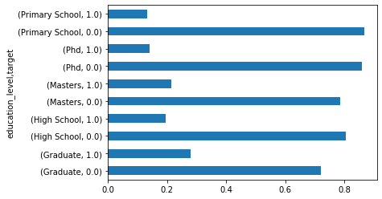
Ordinal features

Slide 8
Data Preprocessing
Train set (60%)
Standard Scaler
Fit & Transfrom
Numerical
Stratified shuffle split
Test set
(20%)
Fill NaN with most frequent value
Ordinal categorical to numeric
Processed output
Input set
Ordinal
Standard Scaler
Transform
Transform
Nominal
CV set
(20%)
Fill NaN with most frequent category, add NaN_indicator attribute
One hot encoder
Standard Scaler

Slide 9
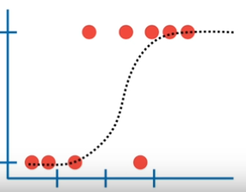
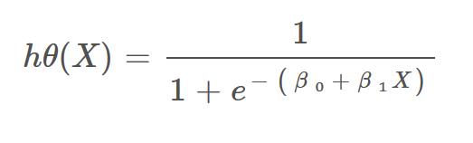
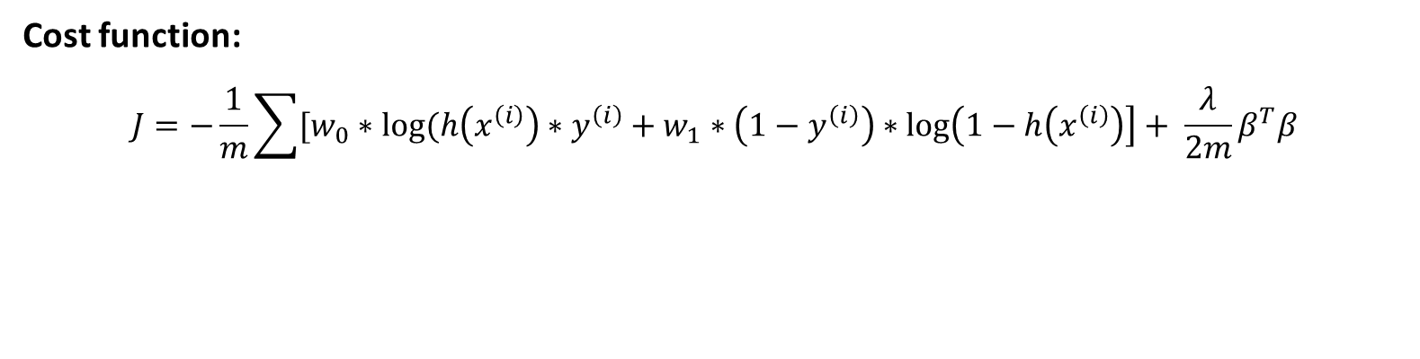
Algorithm
Logistic Regression
Logistic regression will learn the vector β = [β₀, β₁, …, β_{n}] correspond to the hypothesis function
The model will predict 1 if h(X) > threshold and 0 otherwise.
Cost function:
$$J=−\frac{1}{m}\sum{[w_{0}}∗log⁡(h\left(x^{\left(i\right)}\right)∗y^{\left(i\right)}+w_{1}∗\left(1−y^{\left(i\right)}\right)∗\log\left(1−h\left(x^{\left(i\right)}\right)\right]+ \frac{λ}{2m}β^{T}β$$

Slide 10
Hyper-parameters
class_weight = ‘balanced’
penalty = ‘l2’
C = 0.1
solver = ‘lbfgs’
https://en.wikipedia.org/wiki/Limited-memory_BFGS
C value | f1-score on Train set | f1-score on CV set
0.0001 | 0.5757802000895924 | 0.5901639344262296
0.001 | 0.6114649681528662 | 0.6171284634760706
0.01 | 0.6123271889400922 | 0.6185480486781368
0.1 | 0.6133256583681106 | 0.6191275167785234
1.0 | 0.6132374100719424 | 0.6188679245283019
10.0 | 0.6133256583681106 | 0.6188679245283019
100.0 | 0.6133256583681106 | 0.6188679245283019

Slide 11
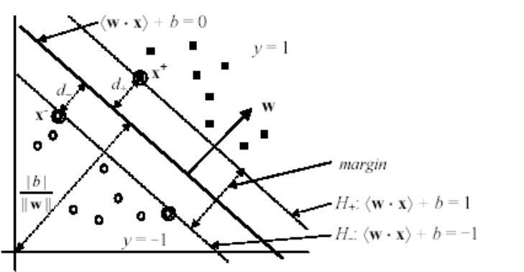
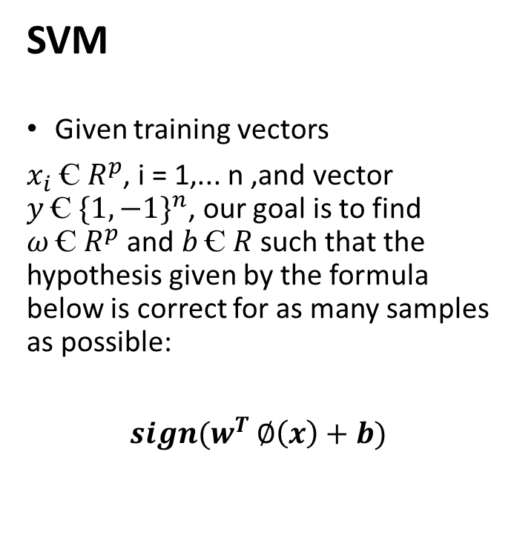

Algorithm
SVM
Given training vectors
$x_{i} Ꞓ R^{p}$, i = 1,... n ,and vector $y Ꞓ {\{1, −1\}}^{n}$, our goal is to find $ω Ꞓ R^{p}$ and $b Ꞓ R$ such that the hypothesis given by the formula below is correct for as many samples as possible:
$sign(w^{T}$ $∅\left(x\right)+b)$
The dual problem:
$$L_{D}= \sum_{i=1}^{r}{a_{i}}−\frac{1}{2} \sum_{i, j=1}^{r}{a_{i} a_{j}{ y}_{i}{ y}_{j} 〈∅\left(x_{i}\right).∅\left(x_{j}\right)〉}$$
subject to: $\left\{\begin{aligned}\sum_{i=1}^{r}{a_{i}y_{i}} =0 \\ 0 ≤a_{i} , i=1,…, n\end{aligned}\right.$
Where $a_{i}$ are called the dual coefficients, and upper-bounded by C.

Slide 12
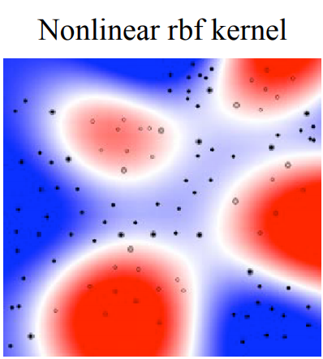

Kernel
The reason for using $∅\left(x\right)$ - a nonlinear mapping instead of x is to transform the input data space into another higher dimension space so that the transformed one is linearly separable
Since we only need the $〈∅\left(x_{i}\right).∅\left(x_{j}\right)〉$, we use kernel function K<x,z> to calculate that value the those inner-products. The kernel that we use in this project is Gaussian RBF:
$K\left(x,z\right)= e^{−\frac{{\left|\left|x−z\right|\right|}^{2}}{2σ}}$ ; where $σ>0.$

Slide 13

Hyper-parameters
kernel = ‘rbf’
C = 200
gamma = 0.0005
With C is the inverse of regularization parameter, and gamma is denoted by $σ$ in the kernel function:
$$K\left(x,z\right)= e^{−\frac{{\left|\left|x−z\right|\right|}^{2}}{2σ}}$$
 | gamma = 0.0002 | gamma = 0.0005 | gamma = 0.001
C = 100 | 0.6073040623718 | 0.60928270042194 | 0.60529743812419
C = 200 | 0.6053169734151 | 0.61030042918455 | 0.59749243406831
C = 500 | 0.6082949308756 | 0.60243055555556 | 0.59939629150496

Slide 14
Result
 |  | Logistic Regression model | SVM model
Train set | Accuracy | 0.77 | 0.80
 | Recall | 0.74 | 0.77
 | Precision | 0.52 | 0.57
 | f1 | 0.61 | 0.66
Cross Validation set | Accuracy | 0.76 | 0.76
 | Recall | 0.77 | 0.74
 | Precision | 0.52 | 0.52
 | f1 | 0.62 | 0.61
Test set | Accuracy | 0.77 | 0.78
 | Recall | 0.79 | 0.79
 | Precision | 0.53 | 0.54
 | f1 | 0.63 | 0.64

Slide 15
Discussion and Improvement
Discussion
SVM only performs slightly better than logistic regression, however the training time and time taken to predict is much longer.
=> For this problem, logistic regression is preferred.
Compared to other teams’ works on kaggle.com, our models’ performances are on par with other complex models using more advanced libraries and algorithms.

Slide 16
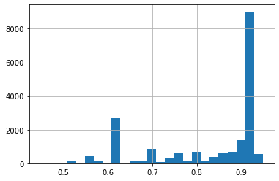
Discussion and Improvement
2. Improvement
Collect more data:
city_development_index is an important factor to the outcome of the problem.
with the current distribution of the data, it is impractical to perform stratified split along this attributes.
Random Forest Classifier: The dataset has many categorical attributes so we hope that we can apply random forest to try to improve the result.

Slide 17
Thank you!

